Slide 1
CNN Architectures

Slide 2
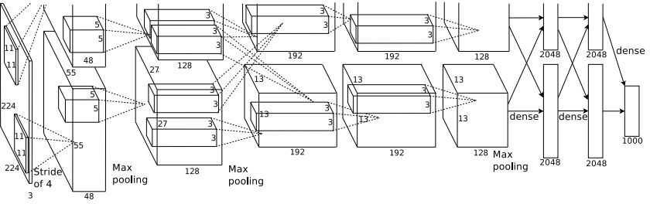
Case Study: AlexNet
[Krizhevsky et al. 2012]
Architecture:
CONV1 MAX POOL1 NORM1 CONV2 MAX POOL2 NORM2 CONV3 CONV4 CONV5
Max POOL3 FC6
FC7 FC8

Slide 3
Case Study: VGGNet
[Simonyan and Zisserman, 2014]
Softmax
FC 1000
FC 4096
FC 4096
Pool
3x3 conv, 512
3x3 conv, 512
3x3 conv, 512
3x3 conv, 512
Pool
3x3 conv, 512
3x3 conv, 512
3x3 conv, 512
3x3 conv, 512
Pool
3x3 conv, 256
3x3 conv, 256
Pool
3x3 conv, 128
3x3 conv, 128
Pool
3x3 conv, 64
3x3 conv, 64
Input
Softmax
FC 1000
FC 4096
FC 4096
Pool
3x3 conv, 512
3x3 conv, 512
3x3 conv, 512
Pool
3x3 conv, 512
3x3 conv, 512
Small filters, Deeper networks
8 layers (AlexNet)
-> 16 - 19 layers (VGG16Net)
Only 3x3 CONV stride 1, pad 1 and 2x2 MAX POOL stride 2
Softmax
FC 1000
FC 4096
FC 4096
Pool
3x3 conv, 256
3x3 conv, 384
Pool
3x3 conv, 384
Pool
5x5 conv, 256
11x11 conv, 96
Input
3x3 conv, 512
Pool
3x3 conv, 256
3x3 conv, 256
Pool
3x3 conv, 128
3x3 conv, 128
Pool
3x3 conv, 64
3x3 conv, 64
Input
11.7% top 5 error in ILSVRC’13 (ZFNet)
-> 7.3% top 5 error in ILSVRC’14
AlexNet
VGG16
VGG19

Slide 4
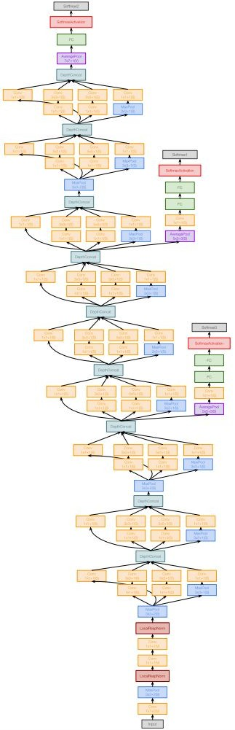
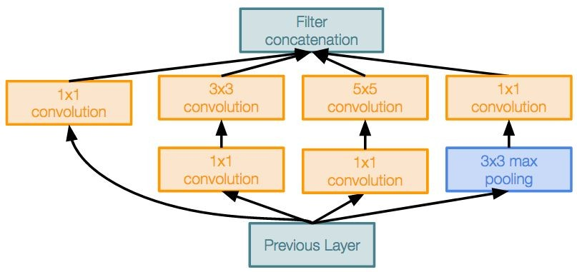
Case Study: GoogLeNet
[Szegedy et al., 2014]
Deeper networks, with computational efficiency
22 layers
Efficient “Inception” module
No FC layers
Only 5 million parameters!
12x less than AlexNet
ILSVRC’14 classification winner (6.7% top 5 error)
Inception module

Slide 5
Case Study: GoogLeNet
[Szegedy et al., 2014]
Apply parallel filter operations on the input from previous layer:
Filter concatenation
Multiple receptive field sizes for convolution (1x1, 3x3, 5x5)
Pooling operation (3x3)
1x1 convolution
3x3 convolution
5x5 convolution
3x3 max pooling
Previous Layer
Concatenate all filter outputs together depth-wise
Naive Inception module

Slide 6
Case Study: ResNet
[He et al., 2015]
Softmax
FC 1000
Pool
3x3 conv, 64
3x3 conv, 64
relu
3x3 conv, 64
Very deep networks using residual connections
3x3 conv, 64
F(x) + x
3x3 conv, 64
3x3 conv, 64
..
.
conv
152-layer model for ImageNet
ILSVRC’15 classification winner (3.57% top 5 error)
Swept all classification and detection competitions in ILSVRC’15 and COCO’15!
3x3 conv, 128
F(x)
X
identity
3x3 conv, 128
relu
3x3 conv, 128
conv
3x3 conv, 128
3x3 conv, 128
3x3 conv, 128 / 2
3x3 conv, 64
X
Residual block
3x3 conv, 64
3x3 conv, 64
3x3 conv, 64
3x3 conv, 64
3x3 conv, 64
Pool
7x7 conv, 64 / 2
Input

Slide 7
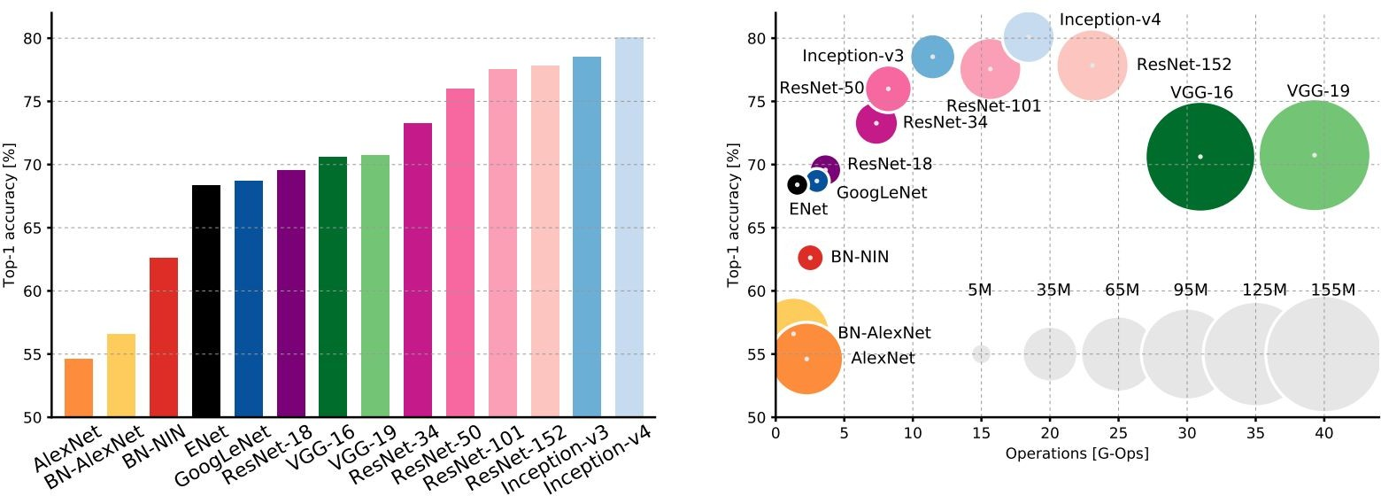
Comparing complexity...

